Slide 1

TRƯỜNG CAO ĐẲNG LÝ TỰ TRỌNG TP.HCM
BẬC ĐÀO TẠO: CAO ĐẲNG CHUYÊN NGHIỆP
GIẢNG VIÊN: NGUYỄN THỊ THU TÂM

Slide 2
BÀI 3 : PLANS AND DREAMS

Slide 3
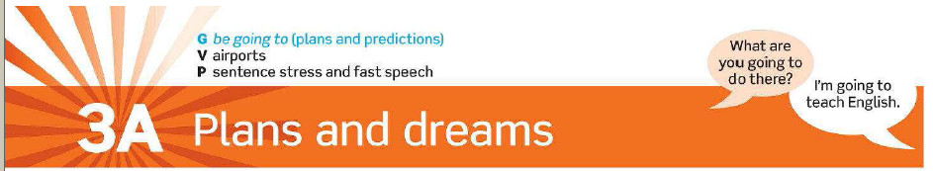

Slide 4



Slide 5
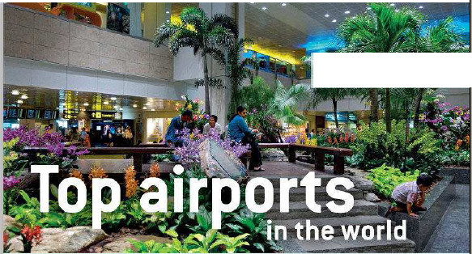


Slide 6
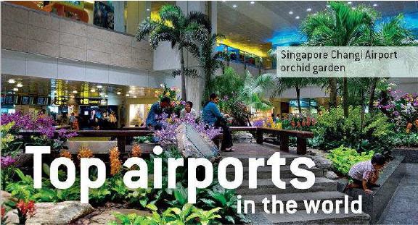
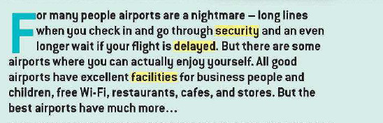

Slide 7
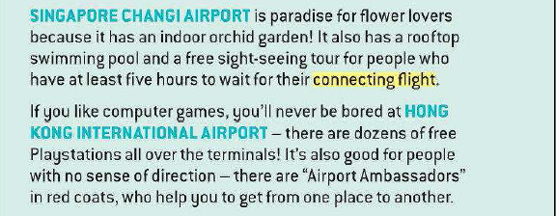

Slide 8
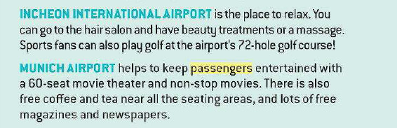

Slide 9
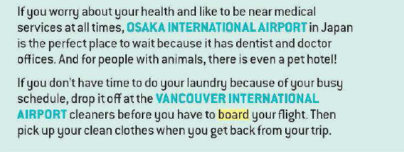

Slide 10
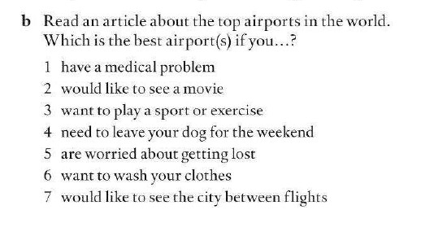

Slide 11
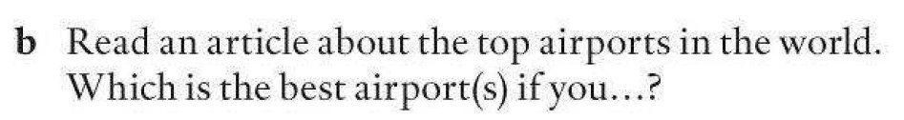




Slide 12




Slide 13

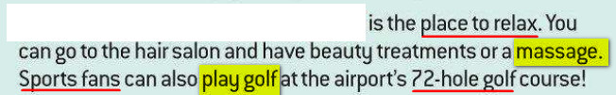


Slide 14
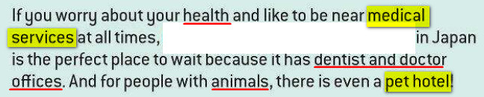


Slide 15



Slide 16

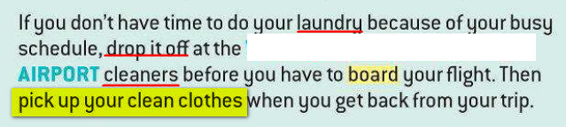

Slide 17
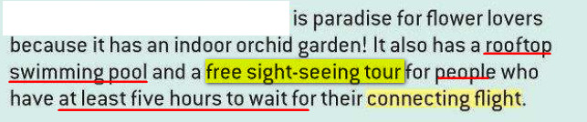


Slide 18


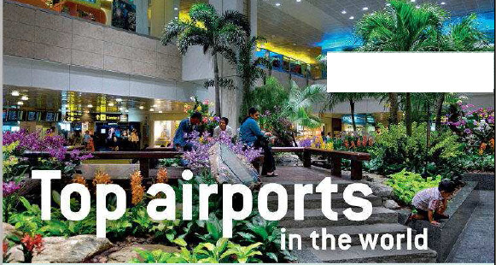


Slide 19
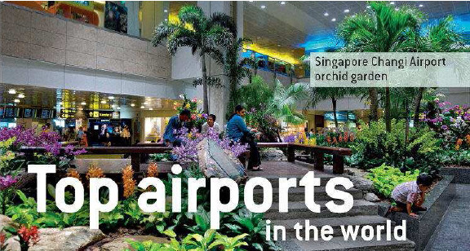
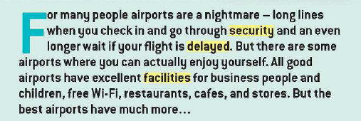

Slide 20
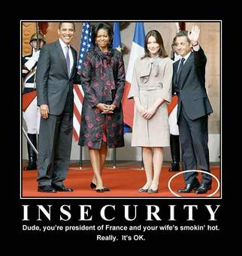
[si'kjuərəti]

Slide 21
Vocabulary
security /sɪ’kjʊərɪti/ (n) : sự an ninh
Ex: There was tight security for Trump’s visit
security forces : lực lượng an ninh
national security : an ninh quốc gia

Slide 22
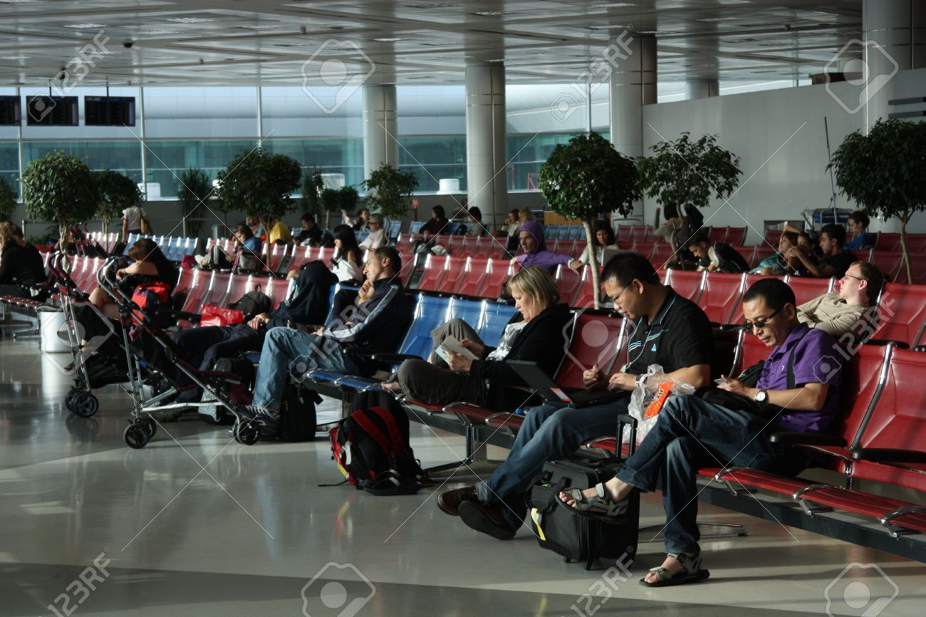

Slide 23
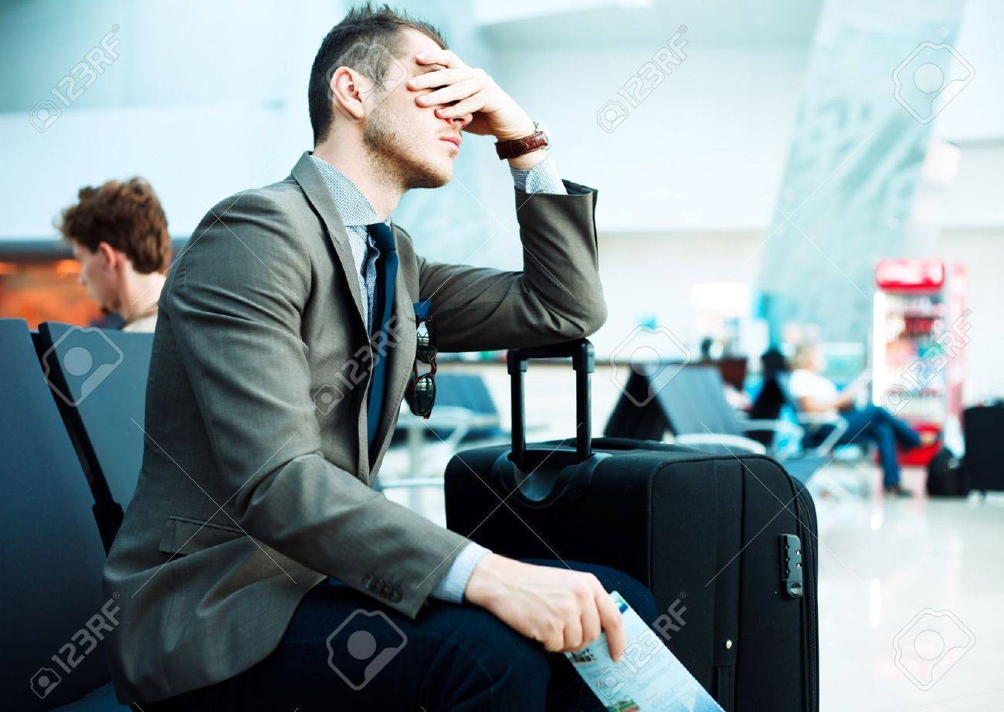


Slide 24
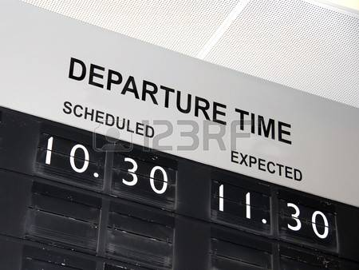


Slide 25

Vocabulary
2. to delay / dɪ’leɪ/ : a period of time when somebody/something has to wait because of a problem that makes something slow or late
= postpone
Ex :

Slide 26
Vocabulary
3. facility /fə’sɪlət̮i/ (n): buildings, services, equipment, etc. that are provided for a particular purpose
Ex : The hotel has special facilities for disabled people.

Slide 27
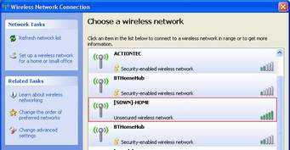

Slide 28
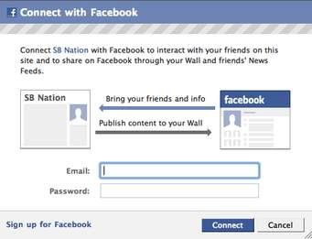

Slide 29
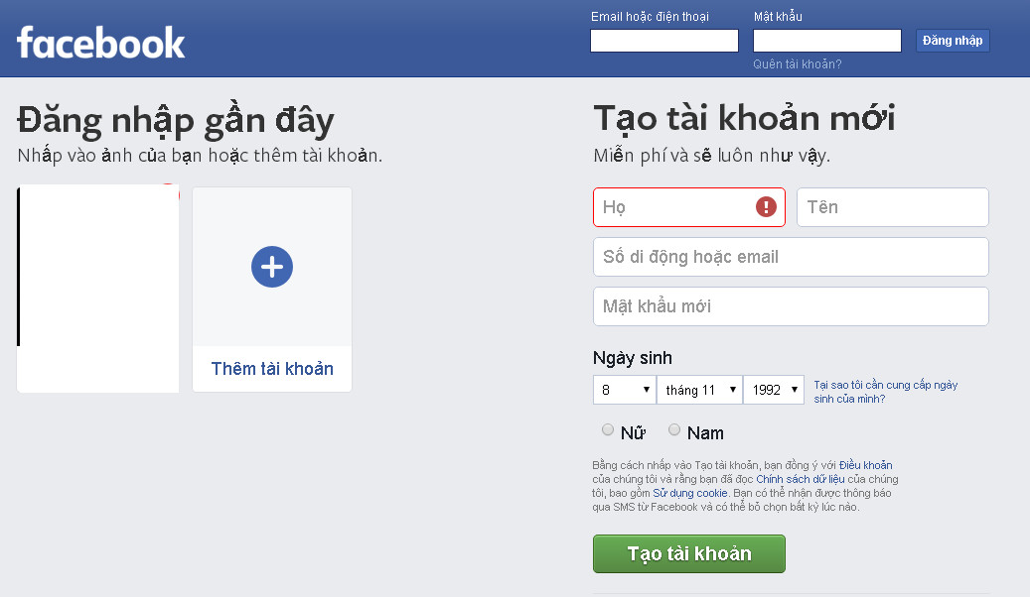

Slide 30
Vocabulary
4. to connect / kə’nɛkt/ : kết nối
(A to/with/and B): join together two or more things; to be joined together
Ex : The towns are connected by train and bus services.

Slide 31
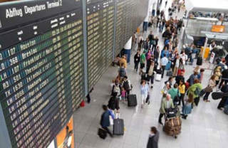

Slide 32
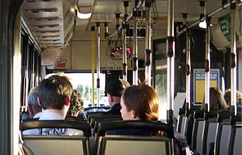
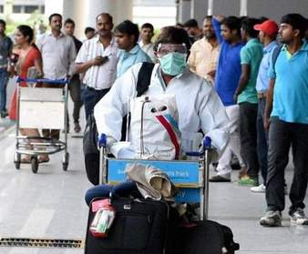

Slide 33
Vocabulary
5. passenger /’pæsəndʒər/ : person who is traveling in a car, bus, train, plane, or ship and who is not driving it or working on it : hành khách
Ex: a passenger on a train

Slide 34
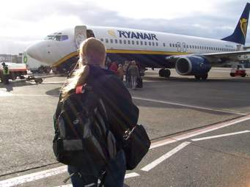

Slide 35
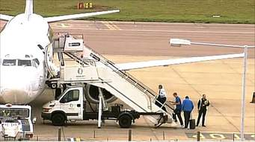

Slide 36
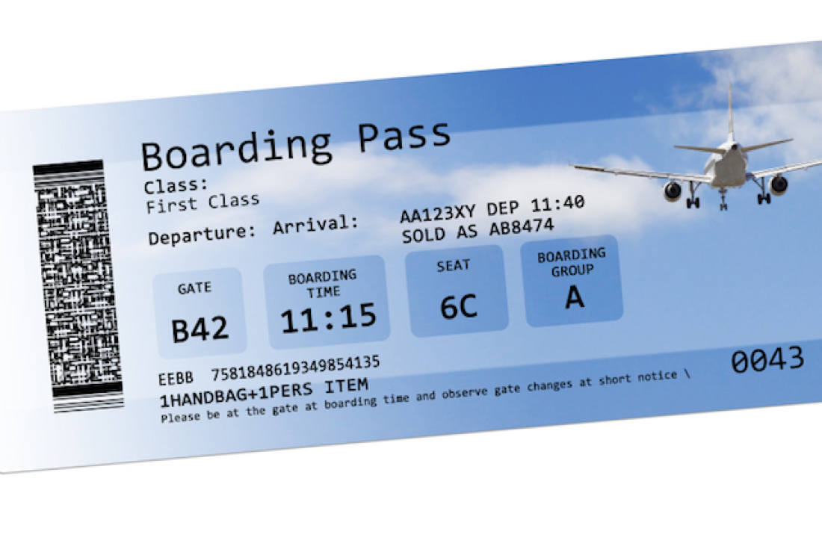

Slide 37
Vocabulary
6. to board /bɔrd/: to go on board or in a ship, an aircraft, or a train
boarding pass : a card that you show before you get on a plane or boat : thẻ lên máy bay/ tàu

Slide 38
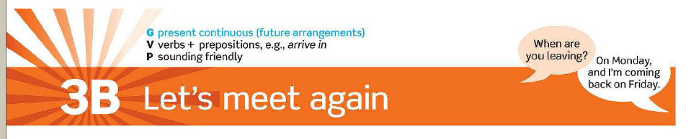



Slide 39
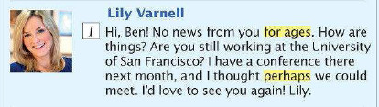
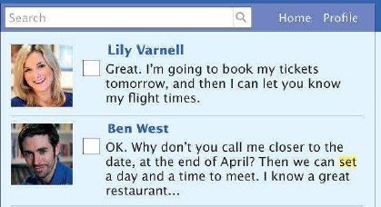
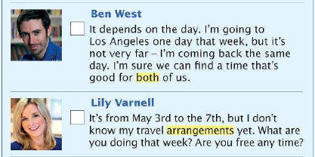
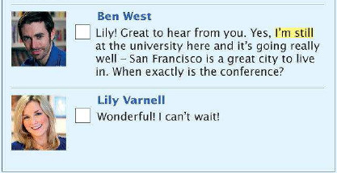

Slide 40

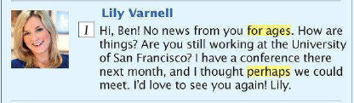

Slide 41
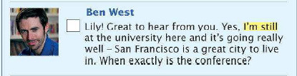
2

Slide 42

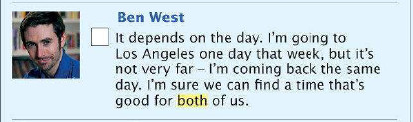
3
4

Slide 43

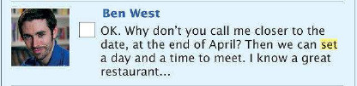

5
6
7

Slide 44
Vocabulary
1. Set /set/ (v)
=
decide something
We can set a day and time to meet.

Slide 45
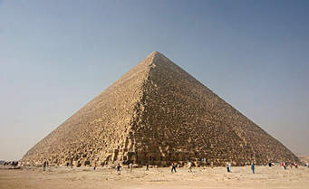

Slide 46
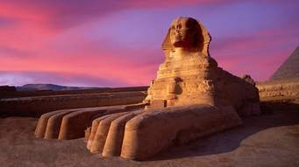

Slide 47
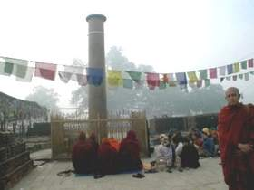

Slide 48
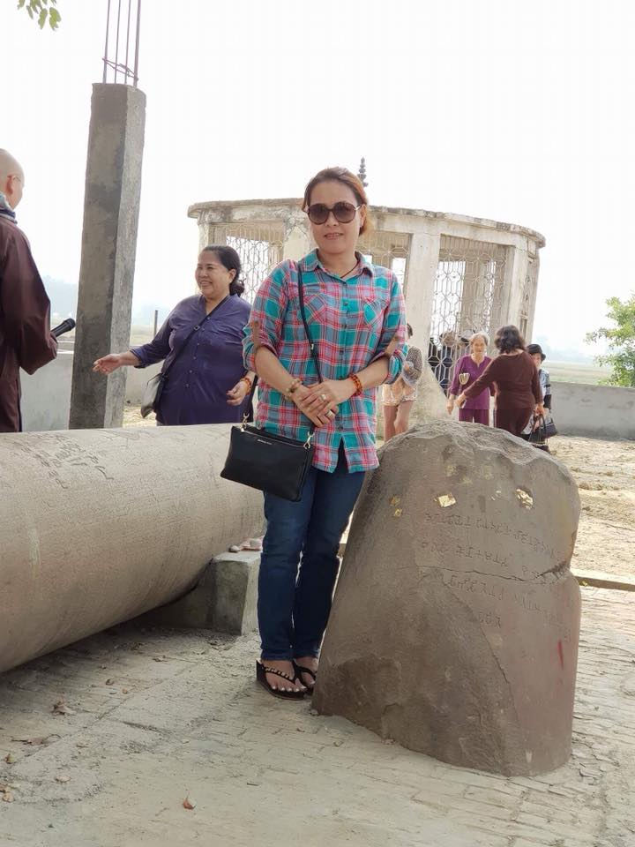

Slide 49
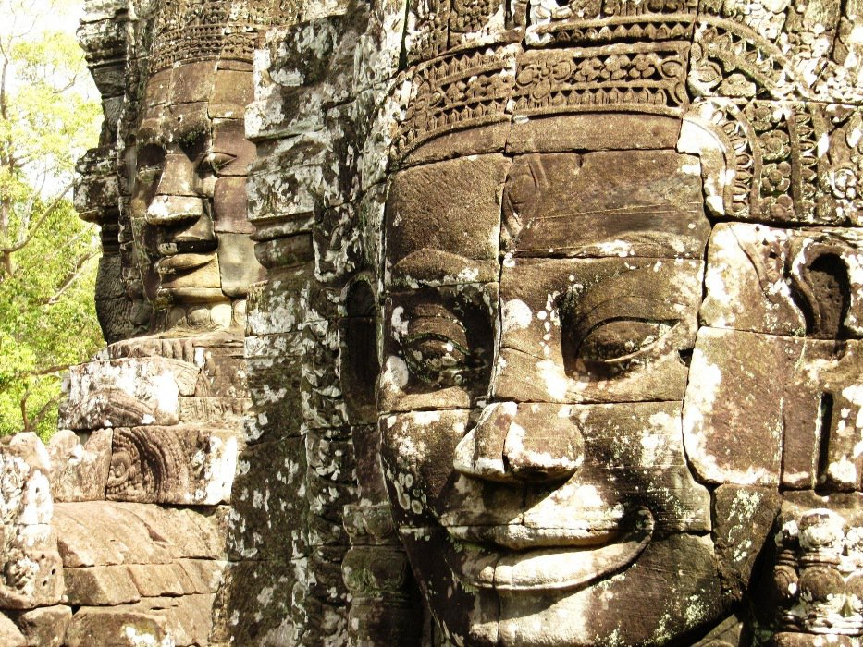
2. For ages : a very long time
We’ve been waiting (for) ages for a bus.

Slide 50
Vocabulary
3. Perhaps /pər’hæps/ (adv)
=
Maybe
Ex: Perhaps it will rain.

Slide 51
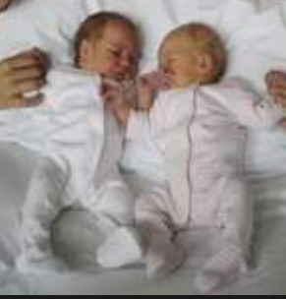

Slide 52
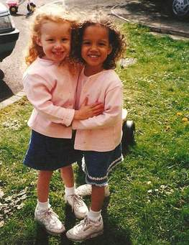

Slide 53
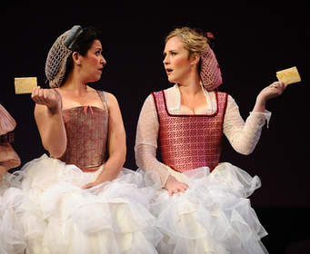

Slide 54
Vocabulary
4. Both: used with plural nouns to mean “the two” or “the one as well as the other”
Ex : Both women were French.

Slide 55
Vocabulary
5. Arrangement / ə’reɪndʒmənt/ (n
= plan, preparation
Have you made any arrangements for a meeting with him?

Slide 56
Vocabulary
6. still (adv) : continuing until a particular point in time and not finishing
Ex : I wrote to them last month and I'm still waiting for a reply.
Ex : Do you still live at the same address?

Slide 57

1. Why does Lily get in touch with Ben ?
Because she has a conference at the University of San Francisco.

Slide 58
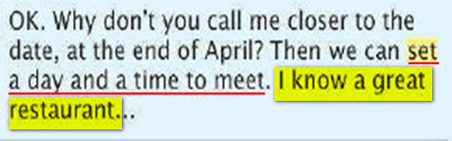
2. What are they planning to do ?
They are planning to meet for dinner in a restaurant that Ben knows.

Slide 59


for ages
2. arrangement
definite /’definit/ (a)
= clear
Ex : I’ll give you a definite answer later.

Slide 60


I’m still
Perhaps
Both
set
decide : to settle or make the result (of something) etc certain
Ex: The last goal decided the match.

Slide 61
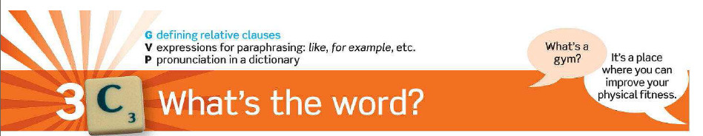


Slide 62
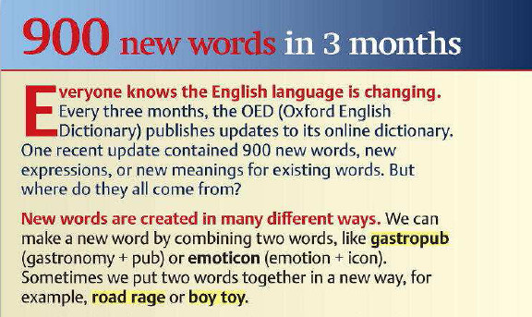

Slide 63

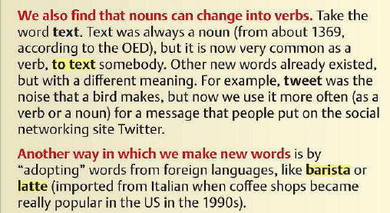

Slide 64


Slide 65

The article mentions four ways of creating new words
1. by combining two words
2. by changing nouns into verbs
3. by adopting foreign words
4. from the names of brands or companies

Slide 66

Boy
toy
to text
barista
road rage
latte
gastropub

Slide 67




Slide 68






Slide 69





